Slide 1
DIYALA UNIVERSITY COLLEGE OF ENGINEERING DEPARTMENT OF COMMUNICATIONS ENGINEERING
Mathematics- II
First Year
lecturer
Wisam Hayder
2020 - 2021

Slide 2
First-Order Differential Equations
Solutions, Slope Fields, and Euler’s Method
Differential Equations
A differential equation is an equation that involves one or more derivatives, or differentials.
Notes:
aaa

Slide 3
Differential equations are classified by:
1. Type: Ordinary or partial.
2. Order: The order of differential equation is the highest order derivative that occurs in the equation.
3. Degree: The exponent of the highest power of the highest order derivative.

Slide 4
First-Order Differential Equations
A differential equation is an ordinary D. Eqs. if the unknown function depends on only one independent variable.
If the unknown function depends on two or more independent variable, the D.Eqs. is a partial D.Eqs..
Notes:
aaa

Slide 5
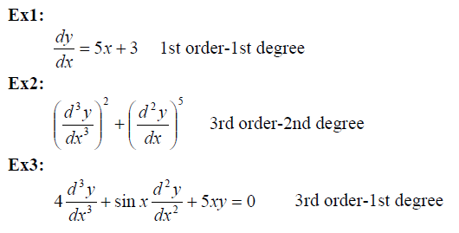
First-Order Differential Equations
Notes:
aaa

Slide 6
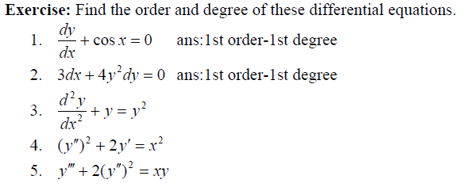
First-Order Differential Equations
Notes:
aaa

Slide 7
First-Order Differential Equations
Solution
The solution of the differential equation in the unknown function y and the independent variable x is a function y(x) that satisfies the differential equation.
Notes:
aaa

Slide 8
First-Order Differential Equations
Note:
The solution in example above is called general solution since it's contain an arbitrary constant c1 and c2, i.e. the general solution of differential equation is the set of all solutions, and the particular solution is any one of these solutions.
Notes:
aaa

Slide 9
First-Order Differential Equations
Notes:
aaa

Slide 10
First-Order Differential Equations
Notes:
aaa

Slide 11
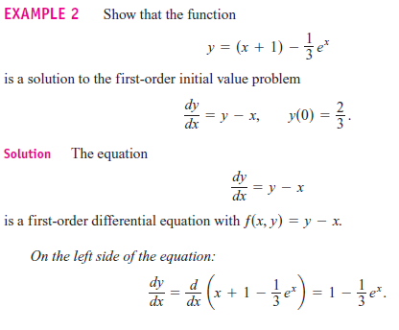
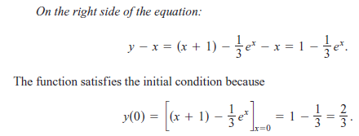
First-Order Differential Equations
Notes:
aaa

Slide 12
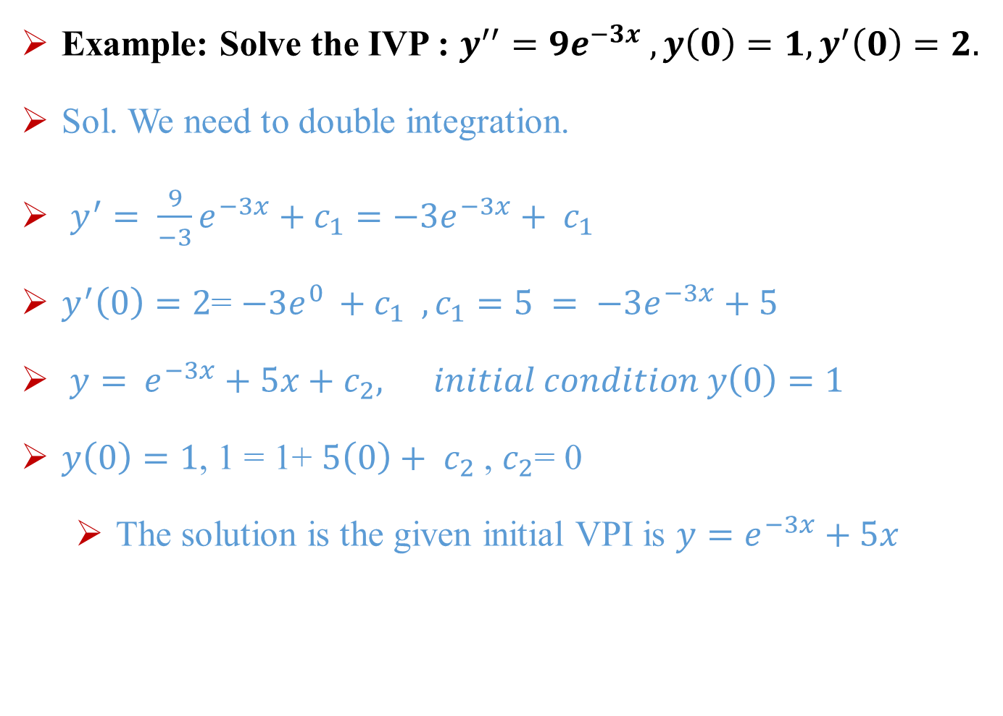
First-Order Differential Equations
Example: Solve the IVP : $y^{′′}=9e^{−3x} , y\left(0\right)=1, y^{′}\left(0\right)=2.$
Sol. We need to double integration.
$y^{′}= \frac{9}{−3}e^{−3x}+c_{1}=−3e^{−3x}+ c_{1}$
$y^{′}\left(0\right)=2$= $−3e^{0 }+c_{1} ,c_{1}=5 = −3e^{−3x}+5$
$y=$ $e^{−3x}+5x+c_{2}, initial condition y\left(0\right)=1$
$y\left(0\right)=1$, 1 = 1+ $5\left(0\right)+ c_{2}$ , $c_{2}$= 0
The solution is the given initial VPI is $y=e^{−3x}+5x$
Notes:
aaa

Slide 13
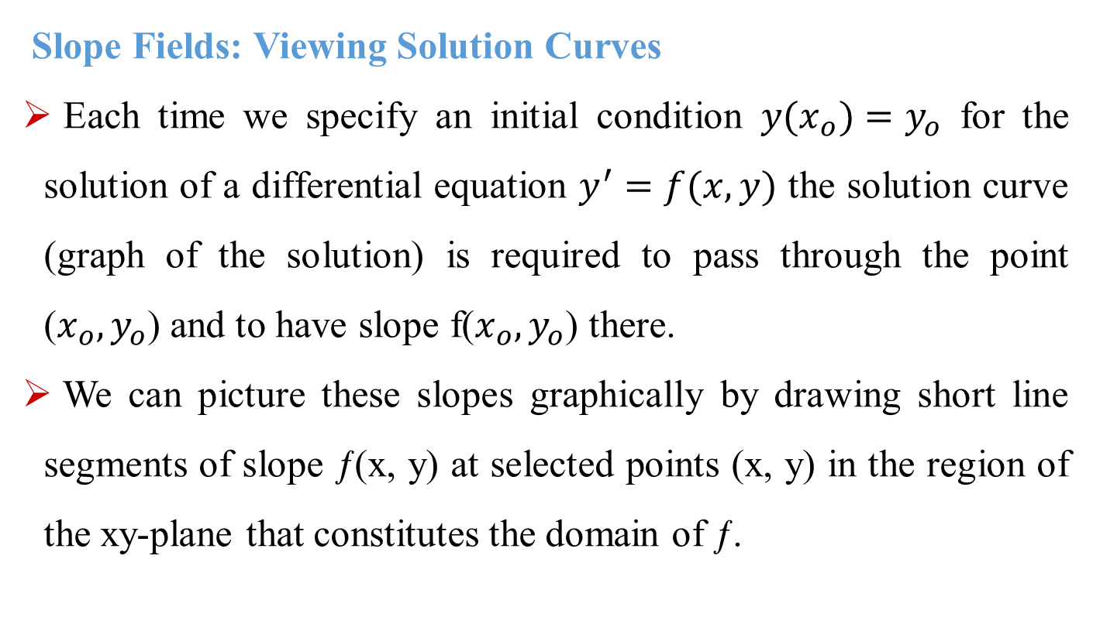
Slope Fields: Viewing Solution Curves
Each time we specify an initial condition ${y(x}_{o})=y_{o}$ for the solution of a differential equation $y^{′}=f(x,y)$ the solution curve (graph of the solution) is required to pass through the point ($x_{o},y_{o}$) and to have slope f($x_{o},y_{o}$) there.
We can picture these slopes graphically by drawing short line segments of slope ƒ(x, y) at selected points (x, y) in the region of the xy-plane that constitutes the domain of ƒ.
Notes:
aaa

Slide 14
Each segment has the same slope as the solution curve through (x, y) and so is tangent to the curve there.
The resulting picture is called a slope field (or direction field) and gives a visualization of the general shape of the solution curves.
Figure 9.2a shows a slope field, with a particular solution sketched into it in Figure 9.2b.
We see how these line segments indicate the direction the solution curve takes at each point it passes through.
Notes:
aaa

Slide 15
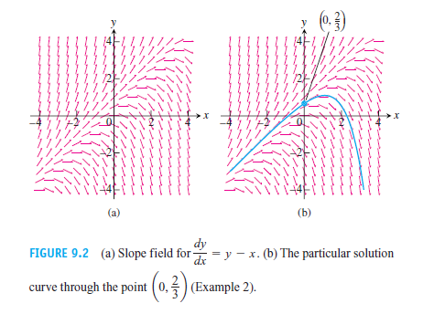
Notes:
aaa

Slide 16
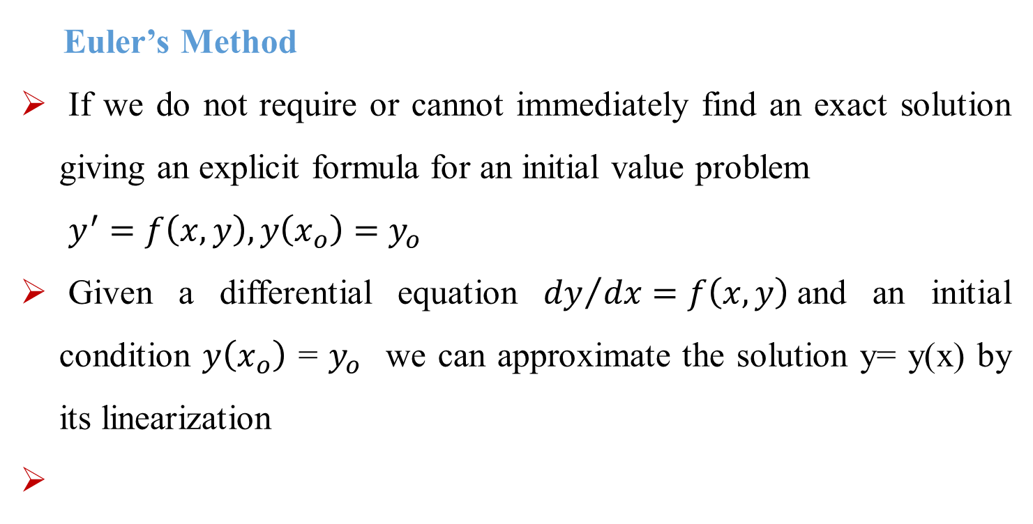
Euler’s Method
If we do not require or cannot immediately find an exact solution giving an explicit formula for an initial value problem
$y^{′}=f\left(x,y\right), y\left(x_{o}\right)=$ $y_{o}$
Given a differential equation ${dy}/{dx=f\left(x,y\right)}$and an initial condition $y\left(x_{o}\right)$ = $y_{o}$ we can approximate the solution y= y(x) by its linearization
Notes:
aaa

Slide 17
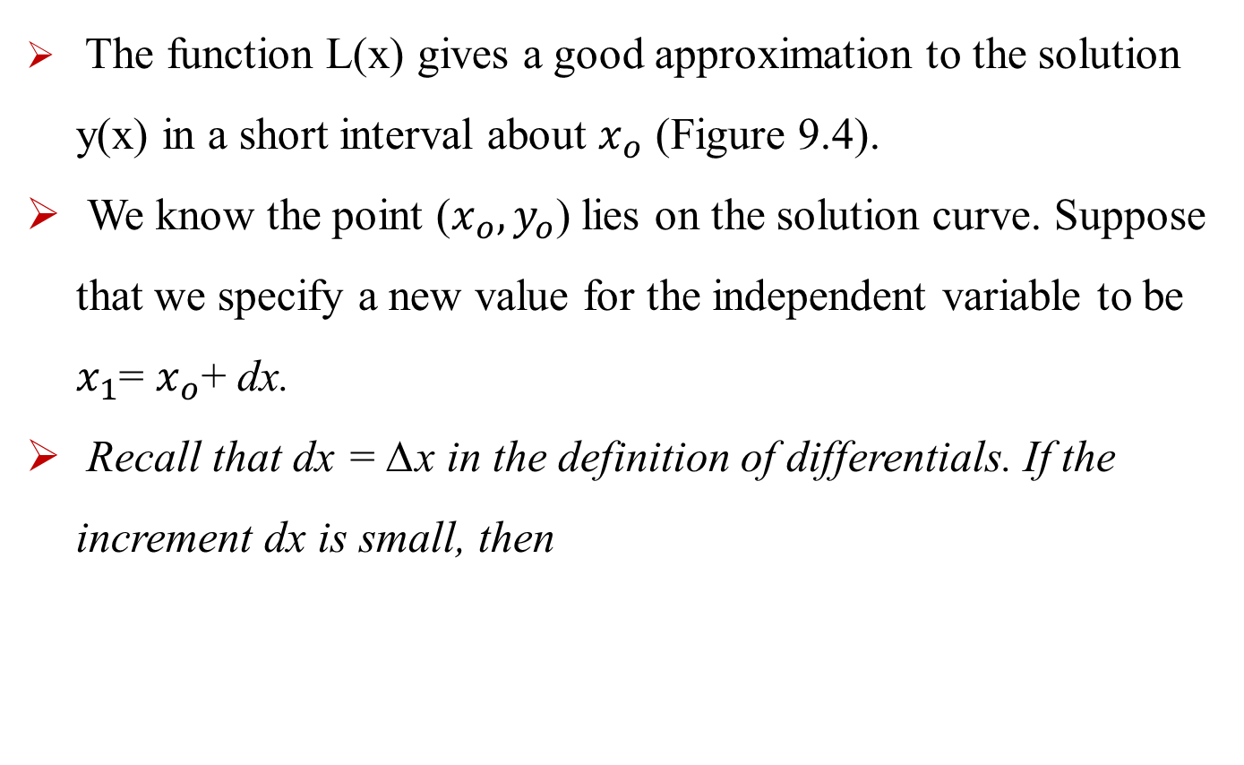
The function L(x) gives a good approximation to the solution y(x) in a short interval about $x_{o}$ (Figure 9.4).
We know the point ($x_{o},y_{o}$) lies on the solution curve. Suppose that we specify a new value for the independent variable to be $x_{1}$= $x_{o}$+ dx.
Recall that dx = ∆x in the definition of differentials. If the increment dx is small, then
Notes:
aaa

Slide 18
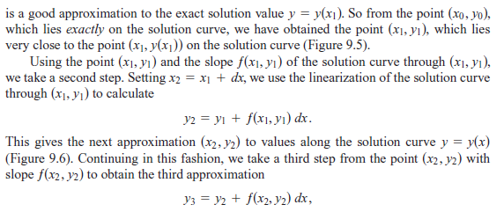
Notes:
aaa

Slide 19
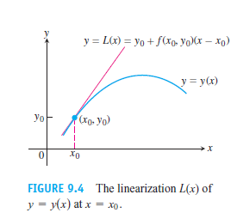
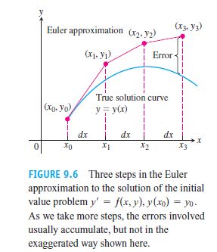
Notes:
aaa

Slide 20
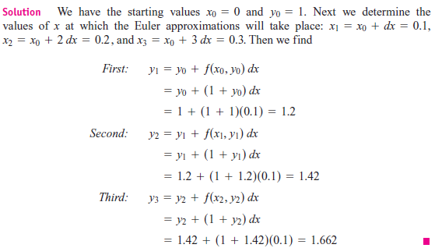
Notes:
aaa

